Slide 1


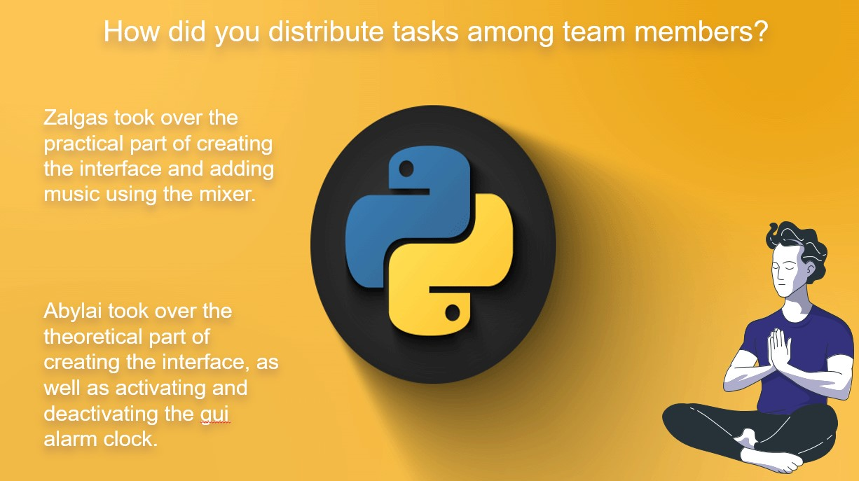
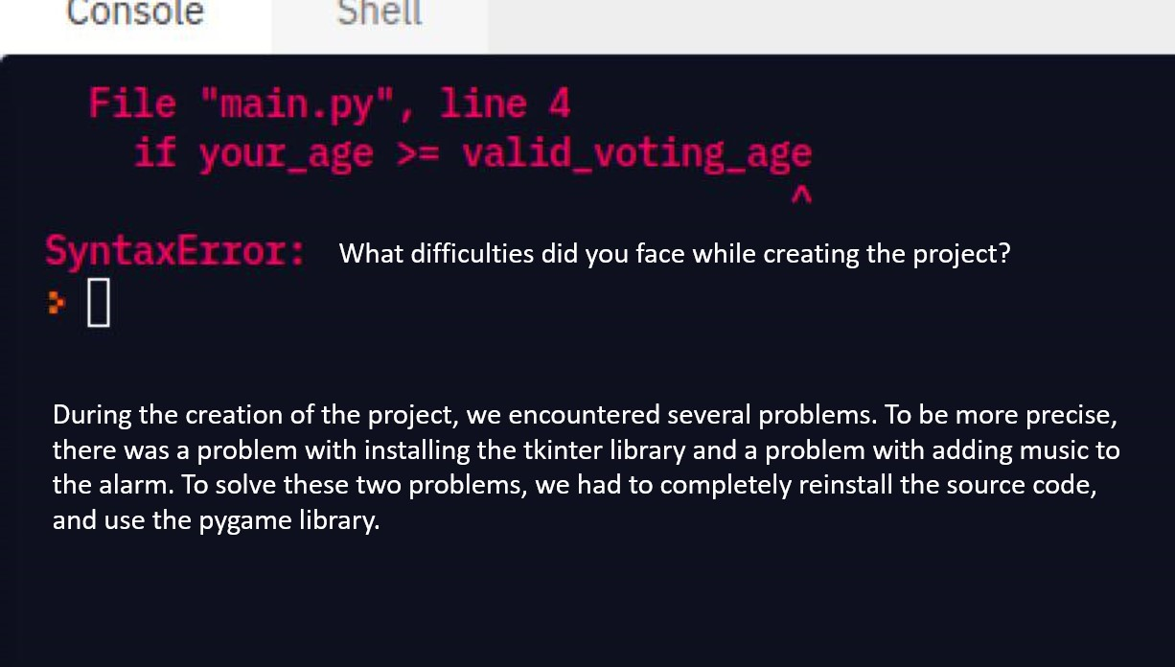


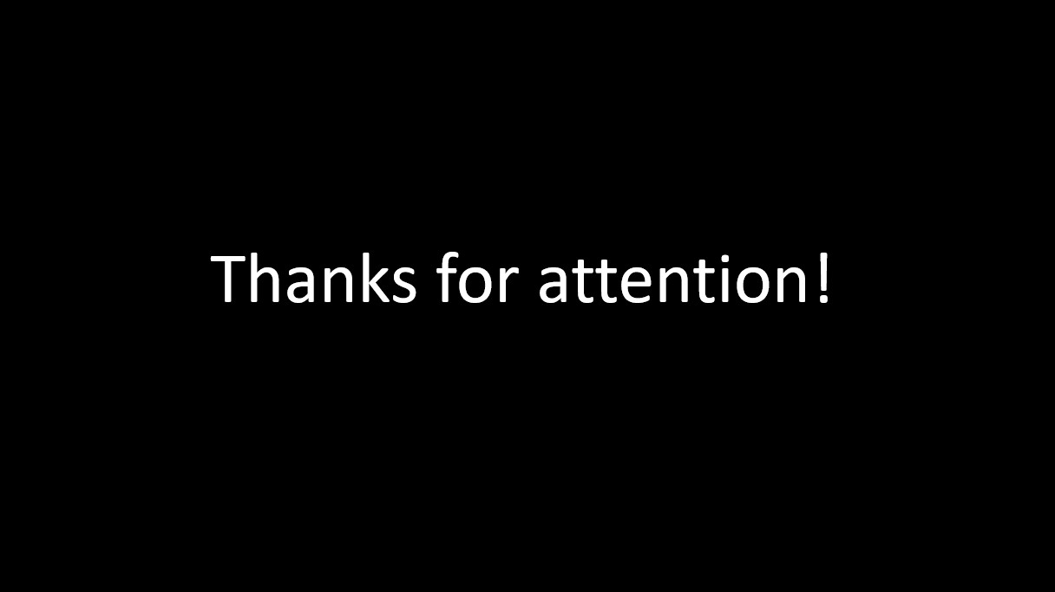

Abdraman Abylaikhan
Kanatuly Zhalgas
CS-2121
GUI ALARM

Slide 2
Abdraman Abylaikhan
Kanatuly Zhalgas
CS-2121
GUI ALARM

Slide 3
Abdraman Abylaikhan
Kanatuly Zhalgas
CS-2121
GUI ALARM

Slide 4
Abdraman Abylaikhan
Kanatuly Zhalgas
CS-2121
GUI ALARM

Slide 5
How did you distribute tasks among team members?
Zalgas took over the practical part of creating the interface and adding music using the mixer.
Abylai took over the theoretical part of creating the interface, as well as activating and deactivating the gui alarm clock.

Slide 6
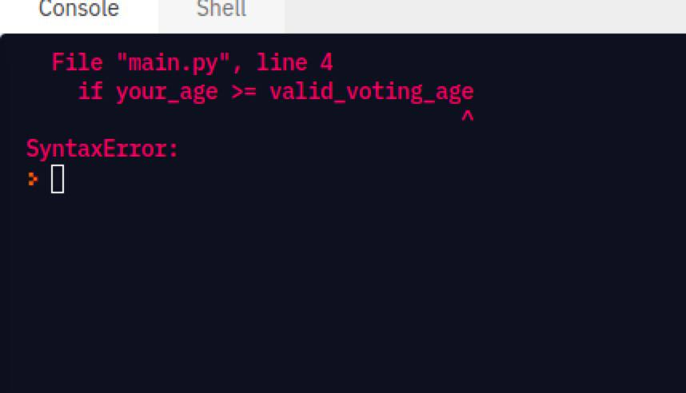
What difficulties did you face while creating the project?
During the creation of the project, we encountered several problems. To be more precise, there was a problem with installing the tkinter library and a problem with adding music to the alarm. To solve these two problems, we had to completely reinstall the source code, and use the pygame library.
Notes:
https://duotone.shapefactory.co/?i=roZgc7SXXmI&f=3fc7ff&t=2c0058&q=_

Slide 7


What new things did you learn while developing the project?
Use datetime and tkinter libraries correctly
Well work in team
Load music using mixer module(from pygame)
Creating interface

Slide 8

What experience did you get while doing project work?
We got good experience in interface development
Gained experience in working with such libraries as
datetime, tkinter, pygame, pillow.
Learned to work in a team and share responsibility in half

Slide 9
Thanks for attention!

